Slide 1

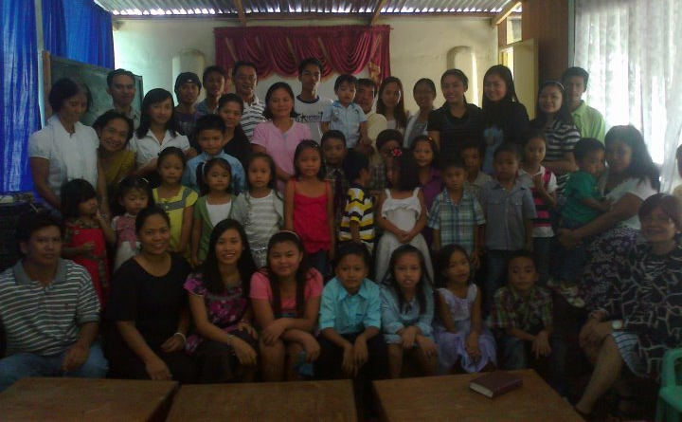
Christ’s Church in Batac
Batac, 2906, Ilocos Norte Philippines
September 4, 2011

Slide 2

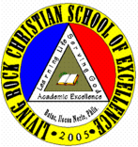
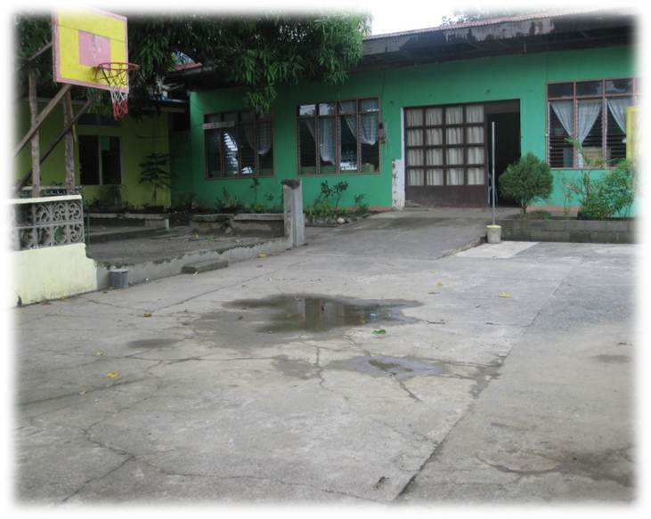
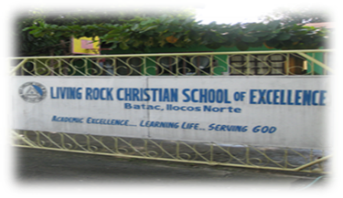
The Living Rock Christian
School of Excellence
Batac, Ilocos Norte Philippines
Academic Excellence, Learning Life, Serving God

Slide 3
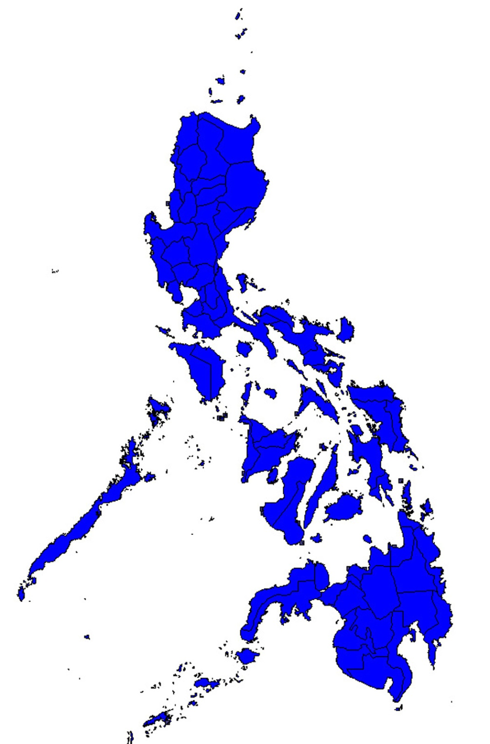
We are located in the northernmost part of the Philippines. A country with 7,100 islands with about 96 million population. The province is chiefly Catholic.

Slide 4
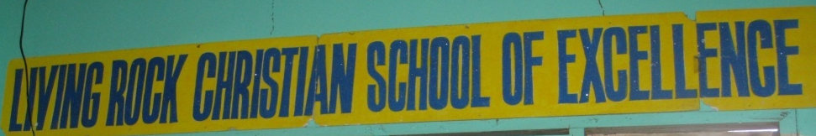
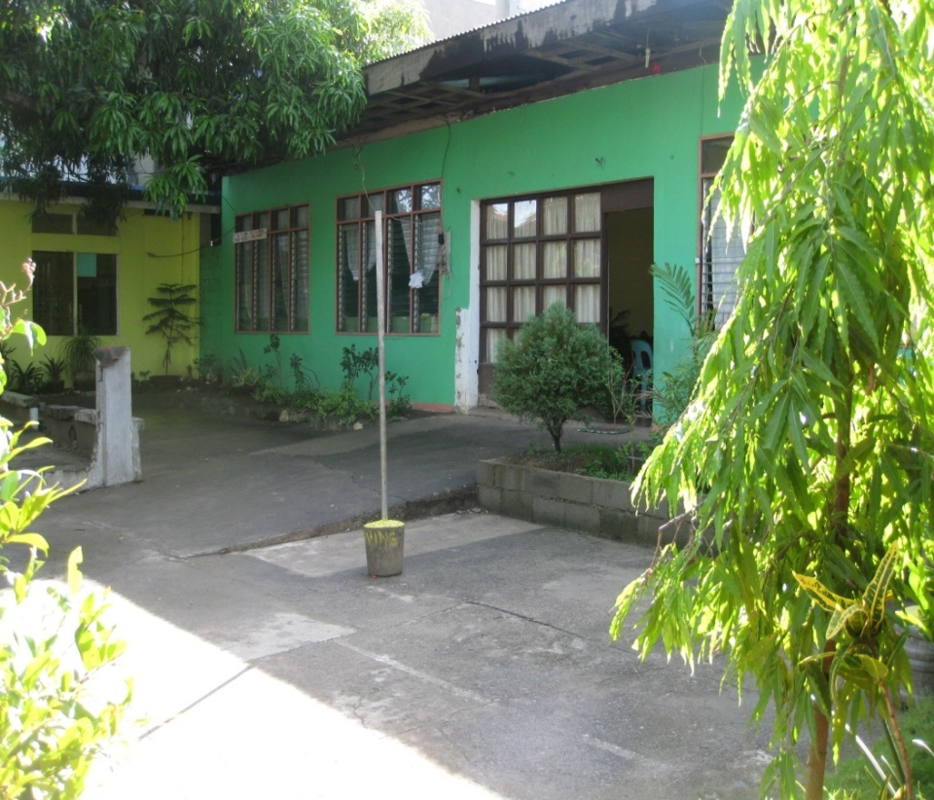
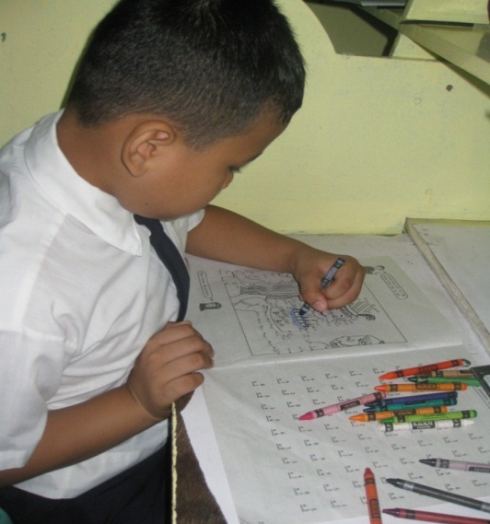
A Little History
2002 Mr. Dante and Mrs. Alma Aguinaldo undertook training at the Bozeman Christian School in Montana, USA.
2003 The Christian School In Dingras, Ilocos Norte was started.
2005 Living Rock Christian School of Excellence in Batac City, Ilocos Norte was established, we started with 7 children, 6 of which were children of church members.
2006 Enrollees kept increasing
2011 After six years of operation, we are working with 57 kids, we will graduate the first batch of grade six pupils!

Slide 5
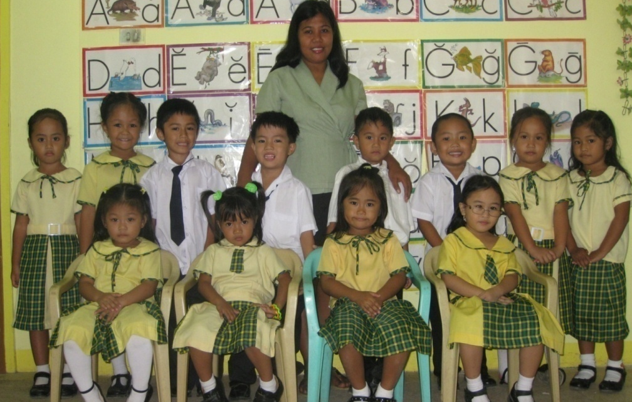
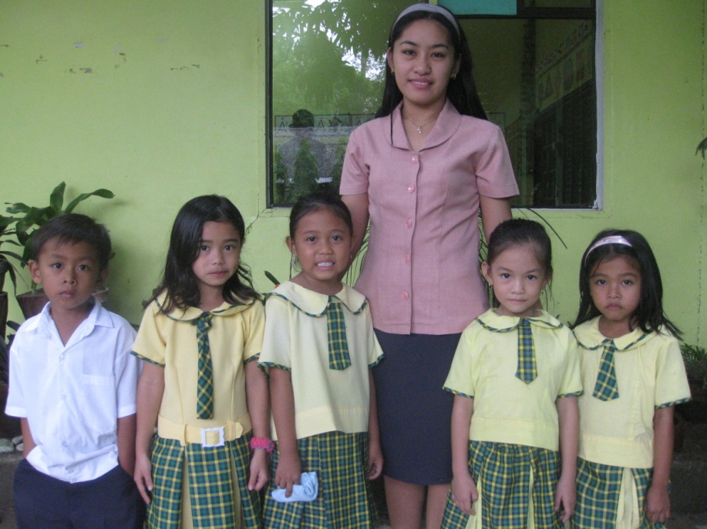
Our Treasures: Our Pupils
The 12 Reading Readiness pupils with Ma’am Rose
The four pupils in the Learning to Read Class with Princess a transferee from public school.
Mrs Girly Esteban supervises the class

Slide 6
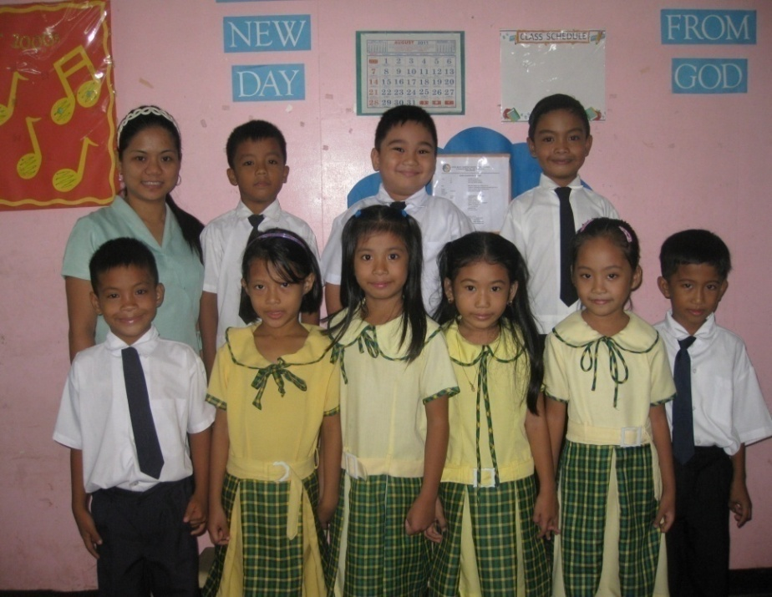
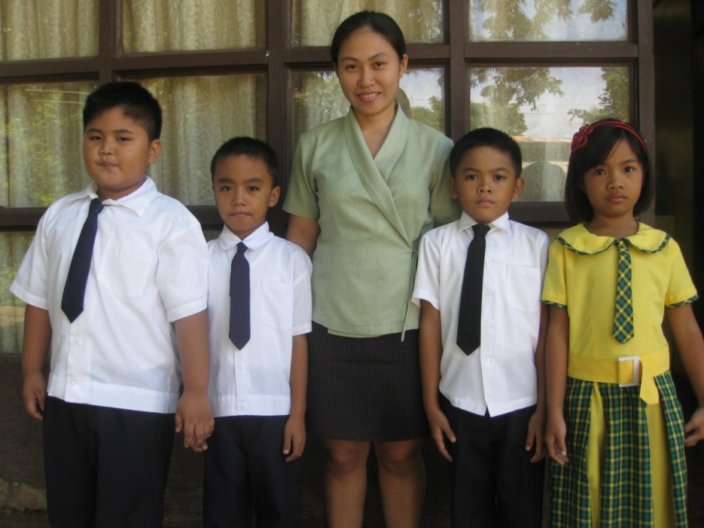
Our Treasures : Our Pupils
Miss Vicky supervises the 6 boys and four girls of the grade 1 class, all of them except 1 came from last year’s LR class.
The 4 pupils of the Grade 2 class have been attending LRCSE since they were in the Reading Readiness Class. Miss Gretchen Barbara Asuncion is their supervisor.

Slide 7
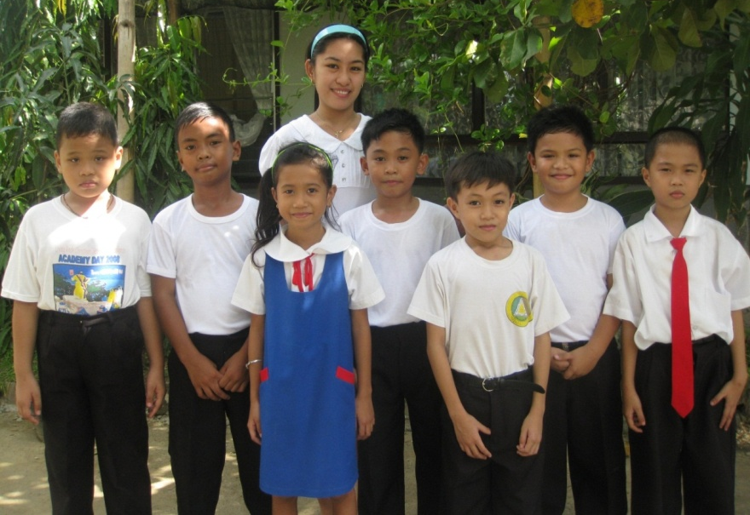
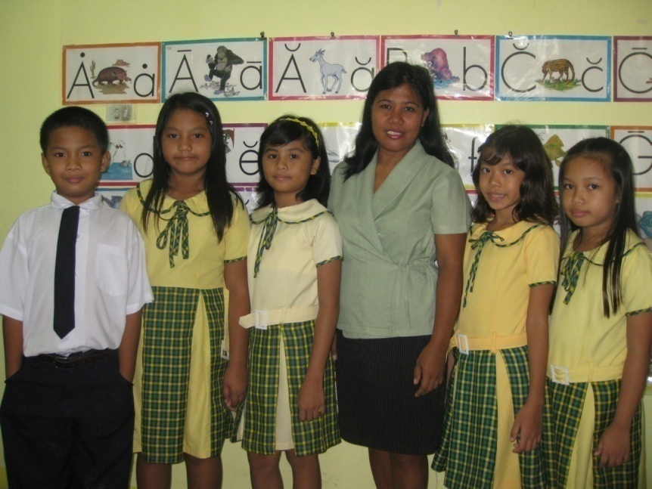
Our Treasures : Our Pupils
There is only one girl in the Grade 3 class, but she can get along well with the guys. Mrs. Esteban is their class adviser.
The Grade 4 girls are very good story tellers. Isaac, the only boy is Mr. Dante’s favorite singer.

Slide 8
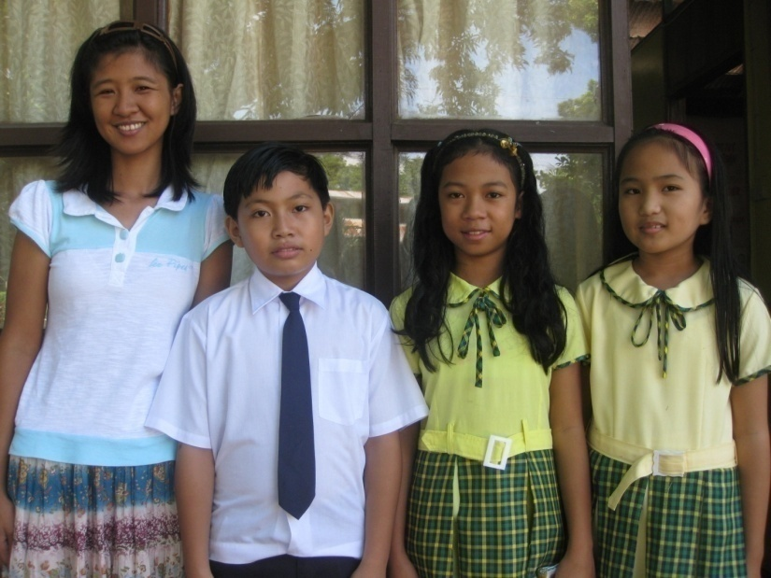
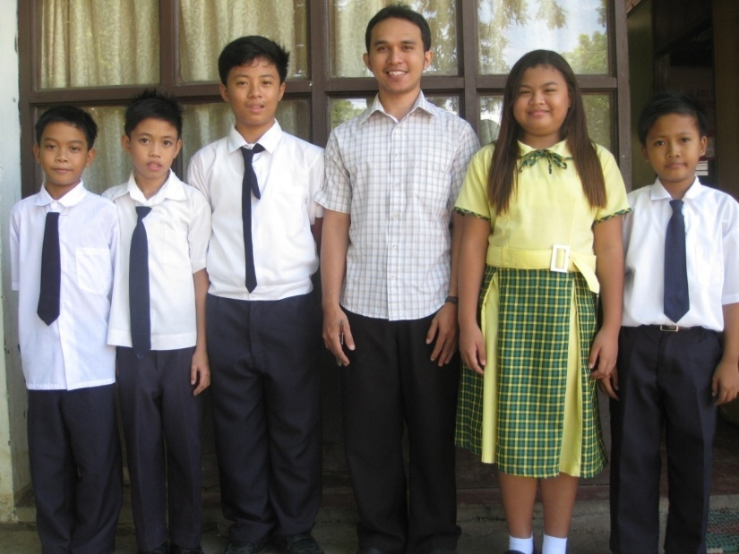
Our Treasures : Our Pupils
The Grade 5 are only three but they are a powerful group.
The Grade 6 pupils with Mr. Nick Colobong the Science and Math teacher. They are supposed to be 6, Jezreel Troy Abiday is sick at the time of the picture taking. They will be our first elementary graduates 5 boys and a girl!

Slide 9
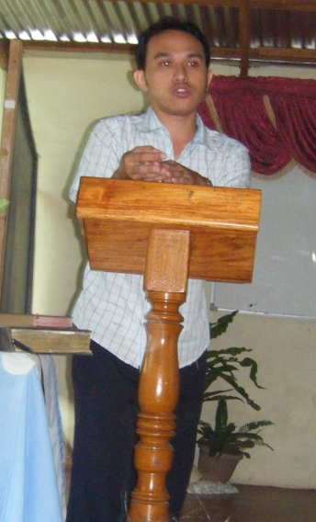
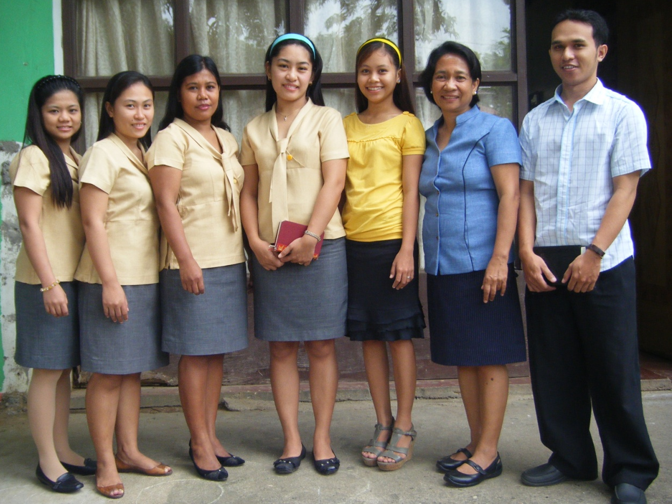
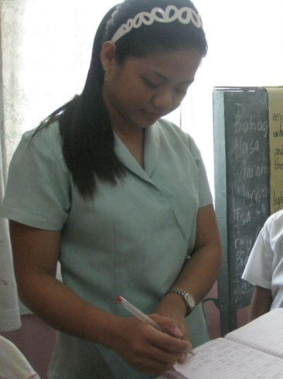
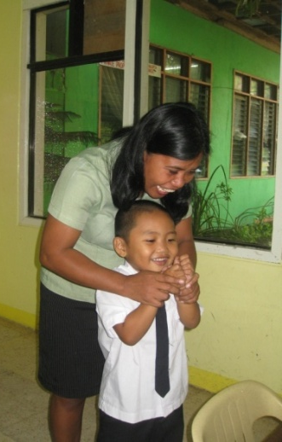
Our Treasures : The Supervisors
Their foremost qualification is that they are Christians, second ; they love the kids, third, they are very competent! Merrie Beatitude is the computer teacher for grade 5 and 6.

Slide 10
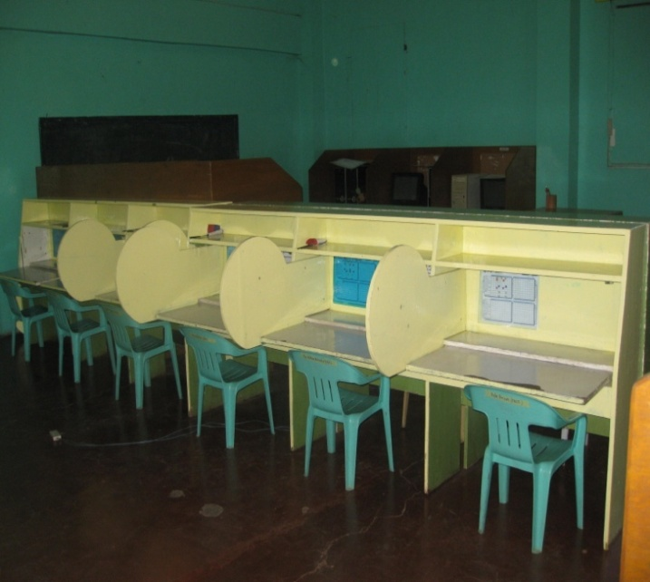
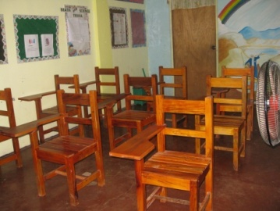
Our Treasures : The Facilities
The PACE Room can contain 27 students at one time.
A Pull Out Room is a requirement of the Dept of Educ. They wont issue us a permit if we don’t do the pull out classes. Hence, we give pull out classes in P.E. (Physical Education) and H.E (Home Econ). We also use the pull out room for Sunday Bible study for children

Slide 11
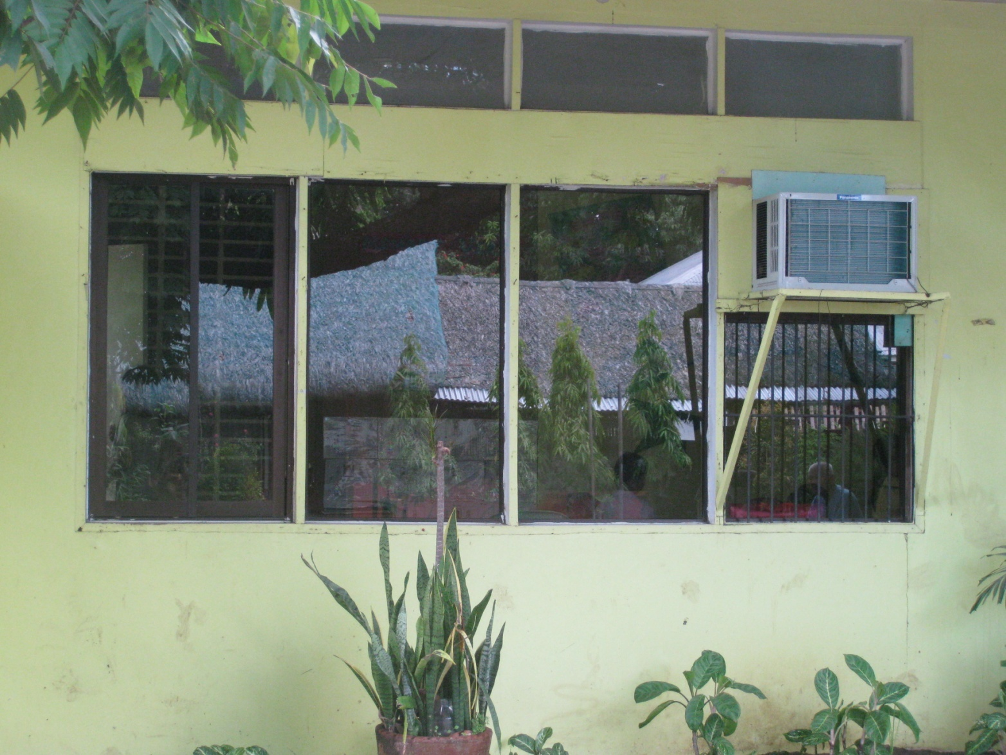
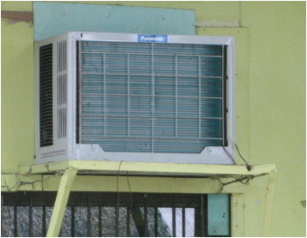
Our Treasures : The Facilities
The Air-Conditioned Room is for the RR, LR and Grade 1

Slide 12
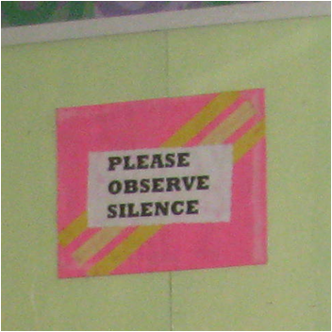
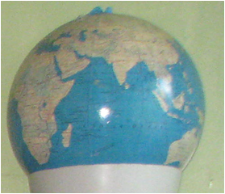
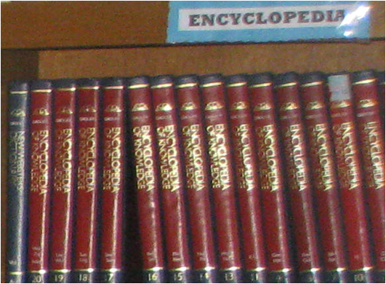
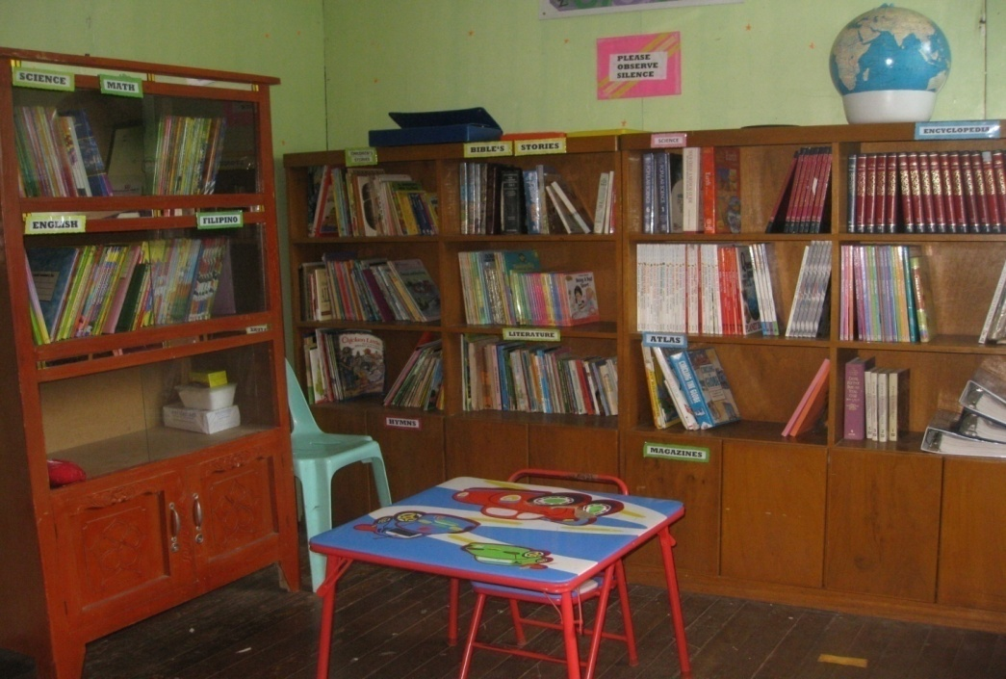
Our Treasures : The Facilities
The Library: Most of the library’s collection are from the US. Mr. Mequel, Miss Chantelle, Miss Jill and Miss Liz brought all your donations and materials. Thank you, they are real treasures!

Slide 13
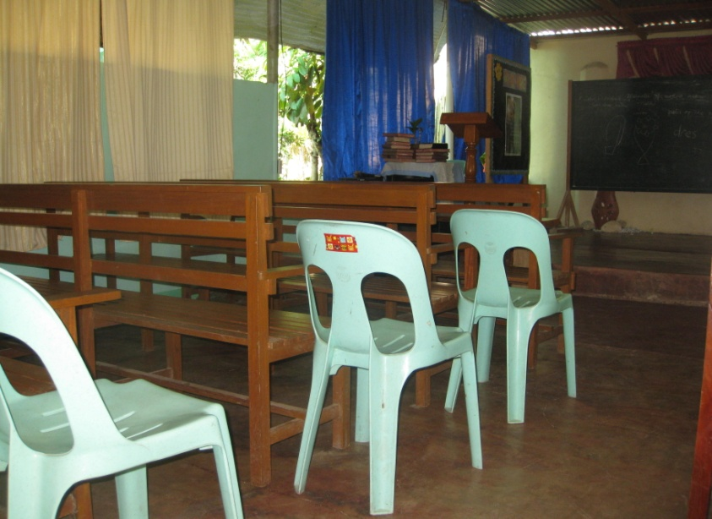
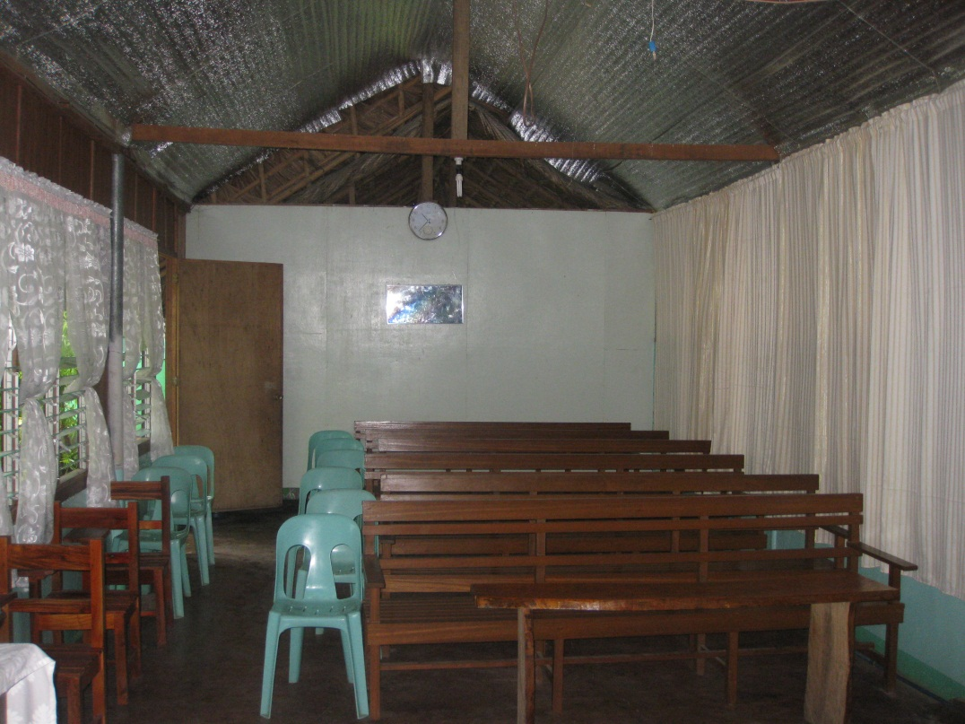
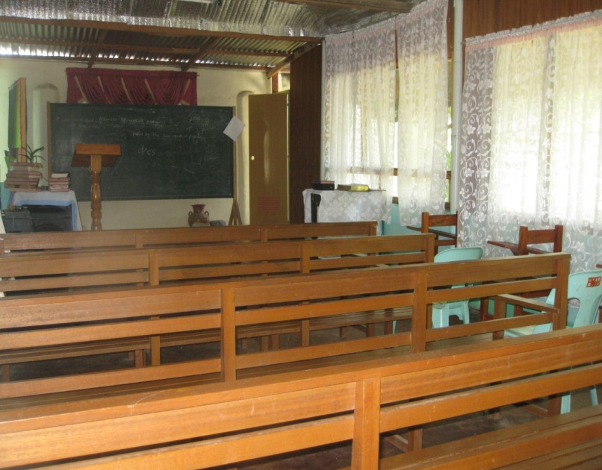
Our Treasures : The Facilities
The CHAPEL is used everyday for devotion and morning exercices, it is also where we hold our program, it can hardly contain our 57 pupils now.,

Slide 14
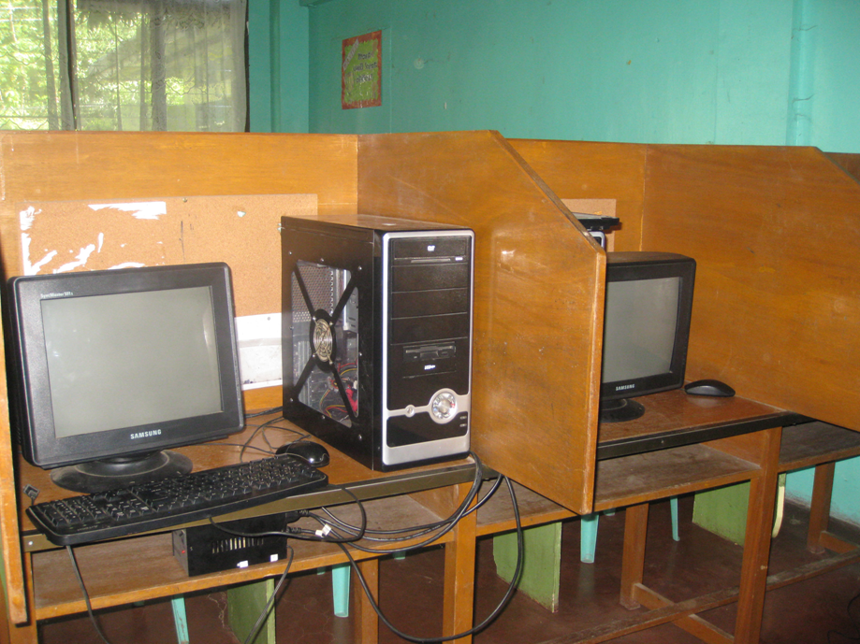
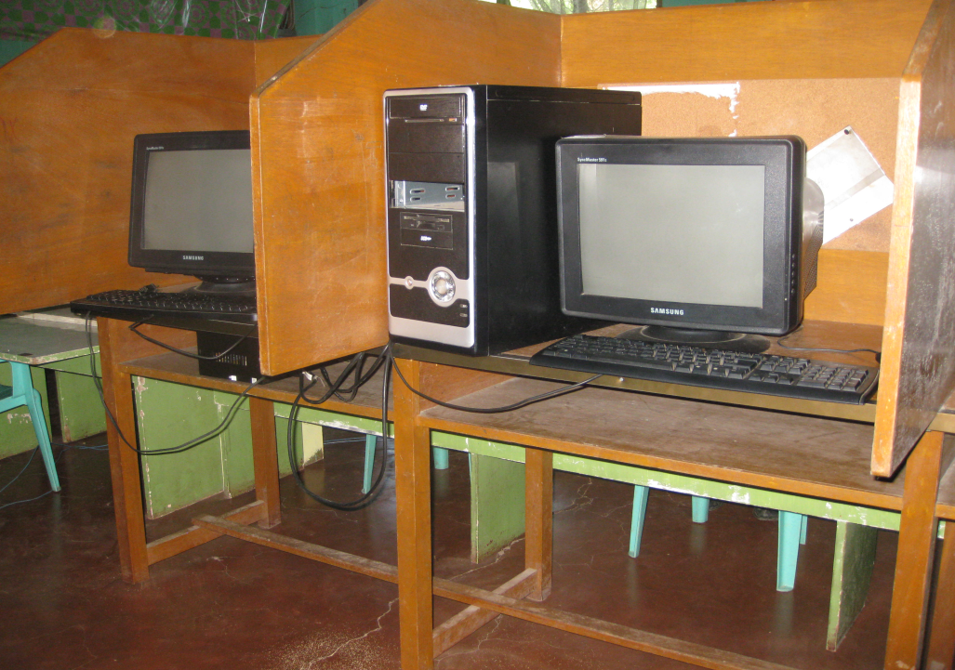
Our Treasures : The Facilities
We just acquired some computers for the computer classes we have seven units including the two laptops donated by the brethren here.

Slide 15
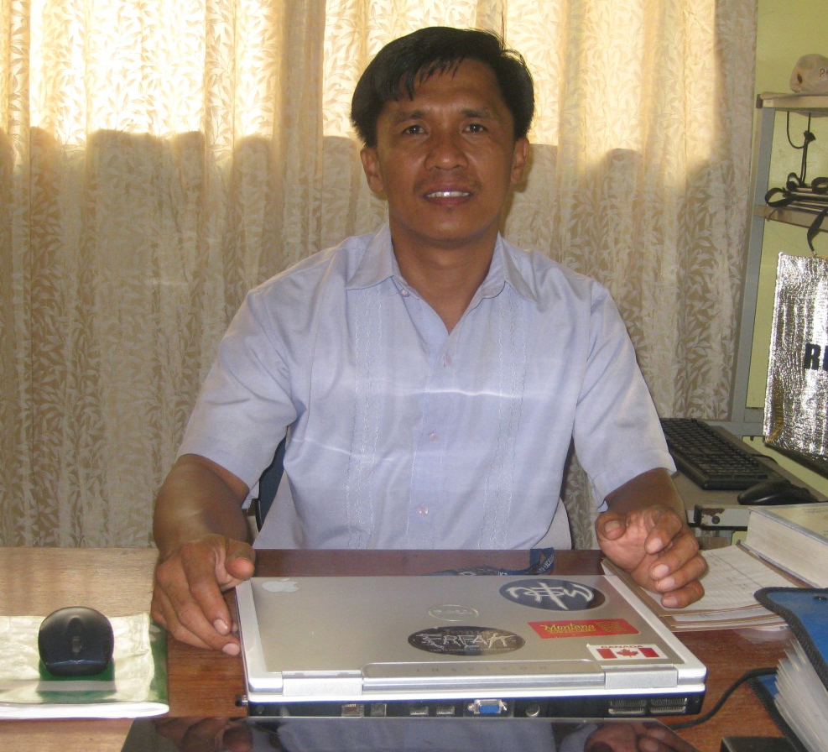
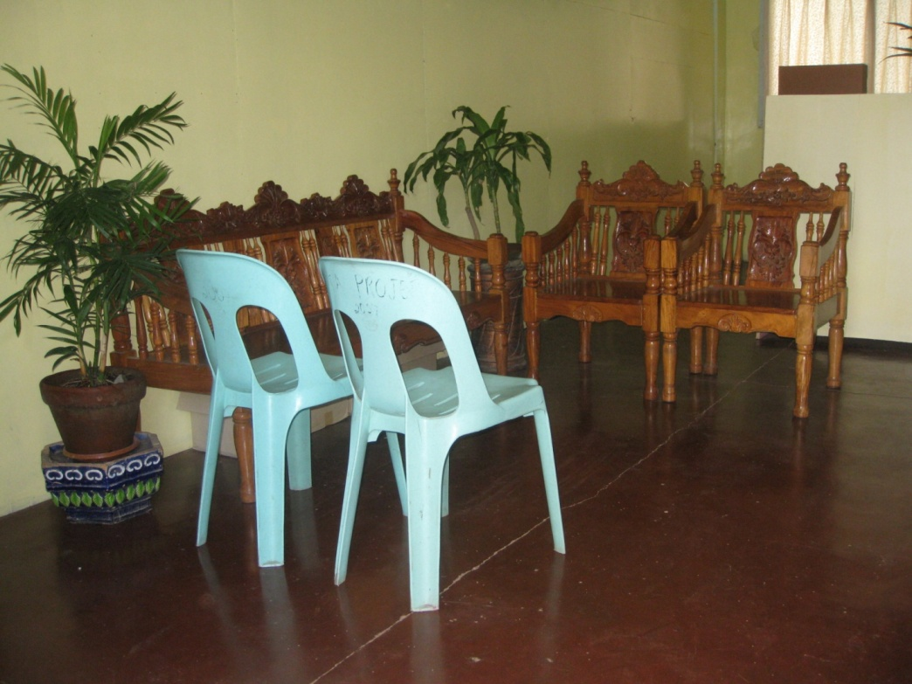
Our Treasures : The Facilities
The Administrator’s Office look so neat but its just a small space
To entertain the parents, talk to kids and entertain Dep Ed officials!

Slide 16
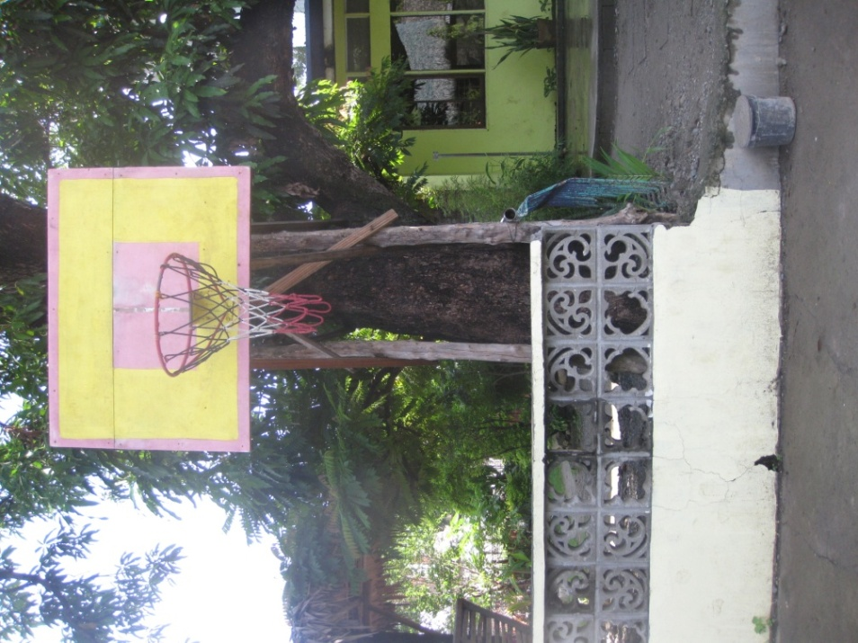
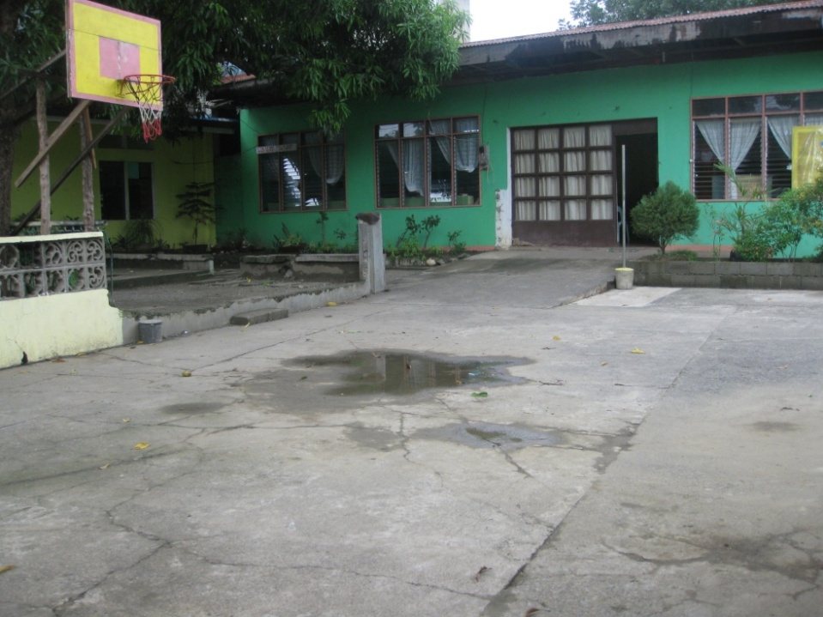
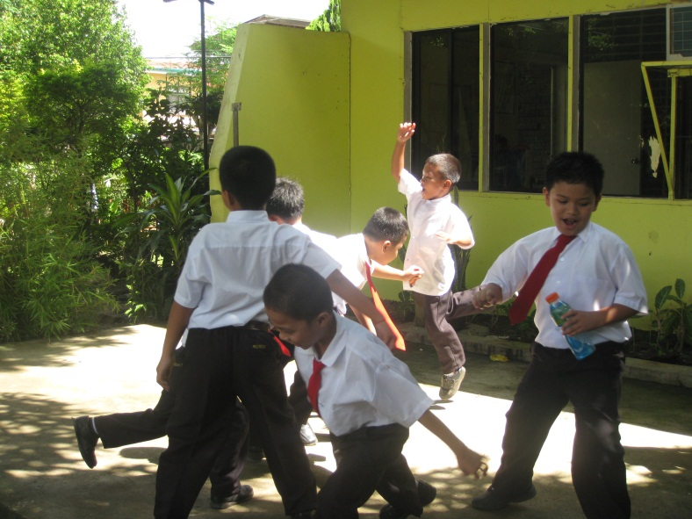
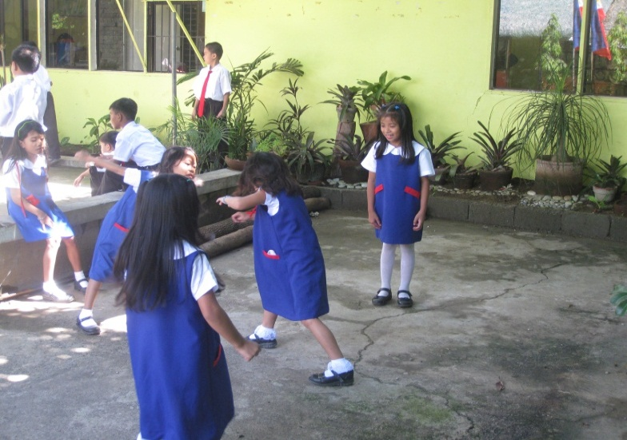
Our Treasures : The Facilities
Play Ground for Our Pupils

Slide 17
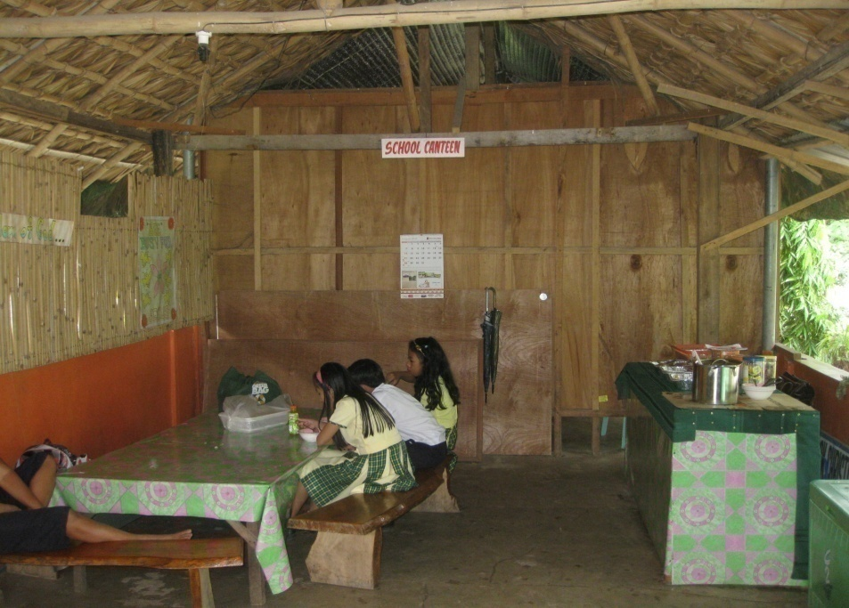
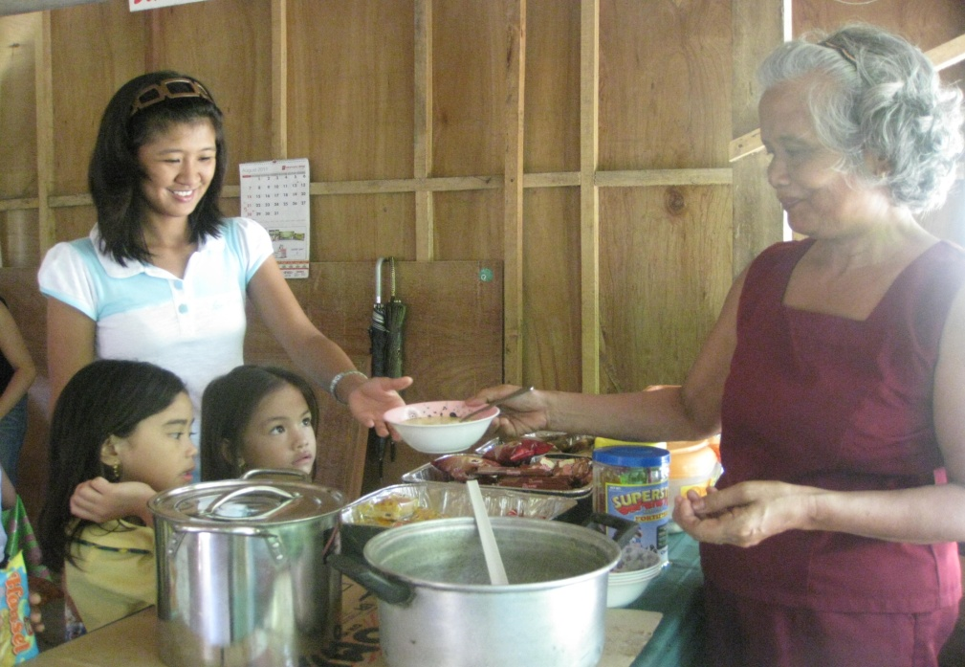
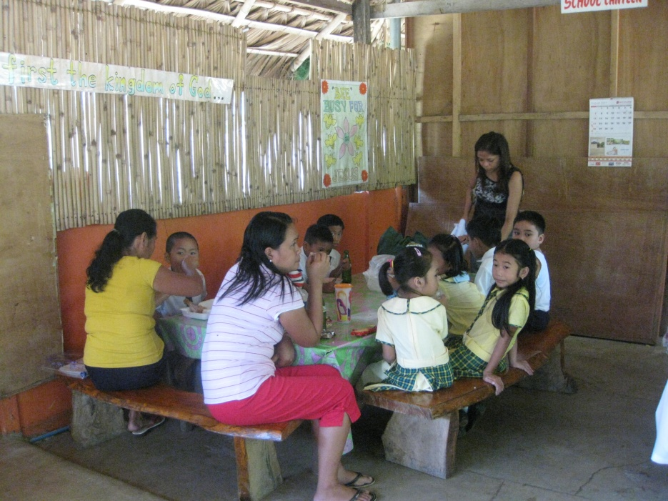
Our Treasures : The Facilities
School Canteen

Slide 18
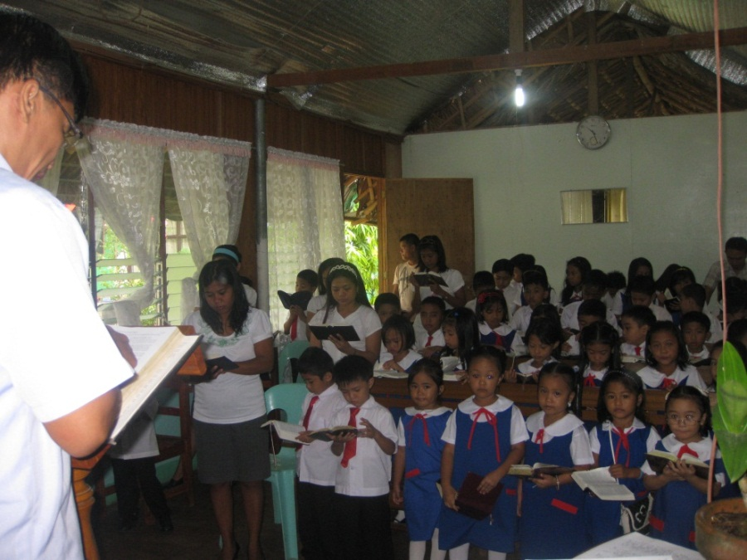
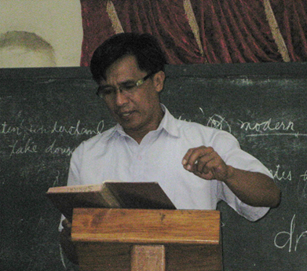
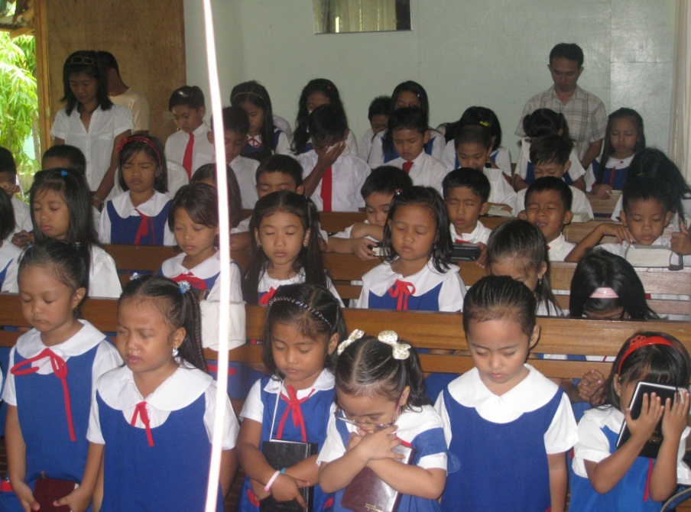
Some of Our Activities
The Chapel Hour is conducted every Wednesday for an hour, the Scripture is read and Mr. Dante explains the lessons to the children

Slide 19

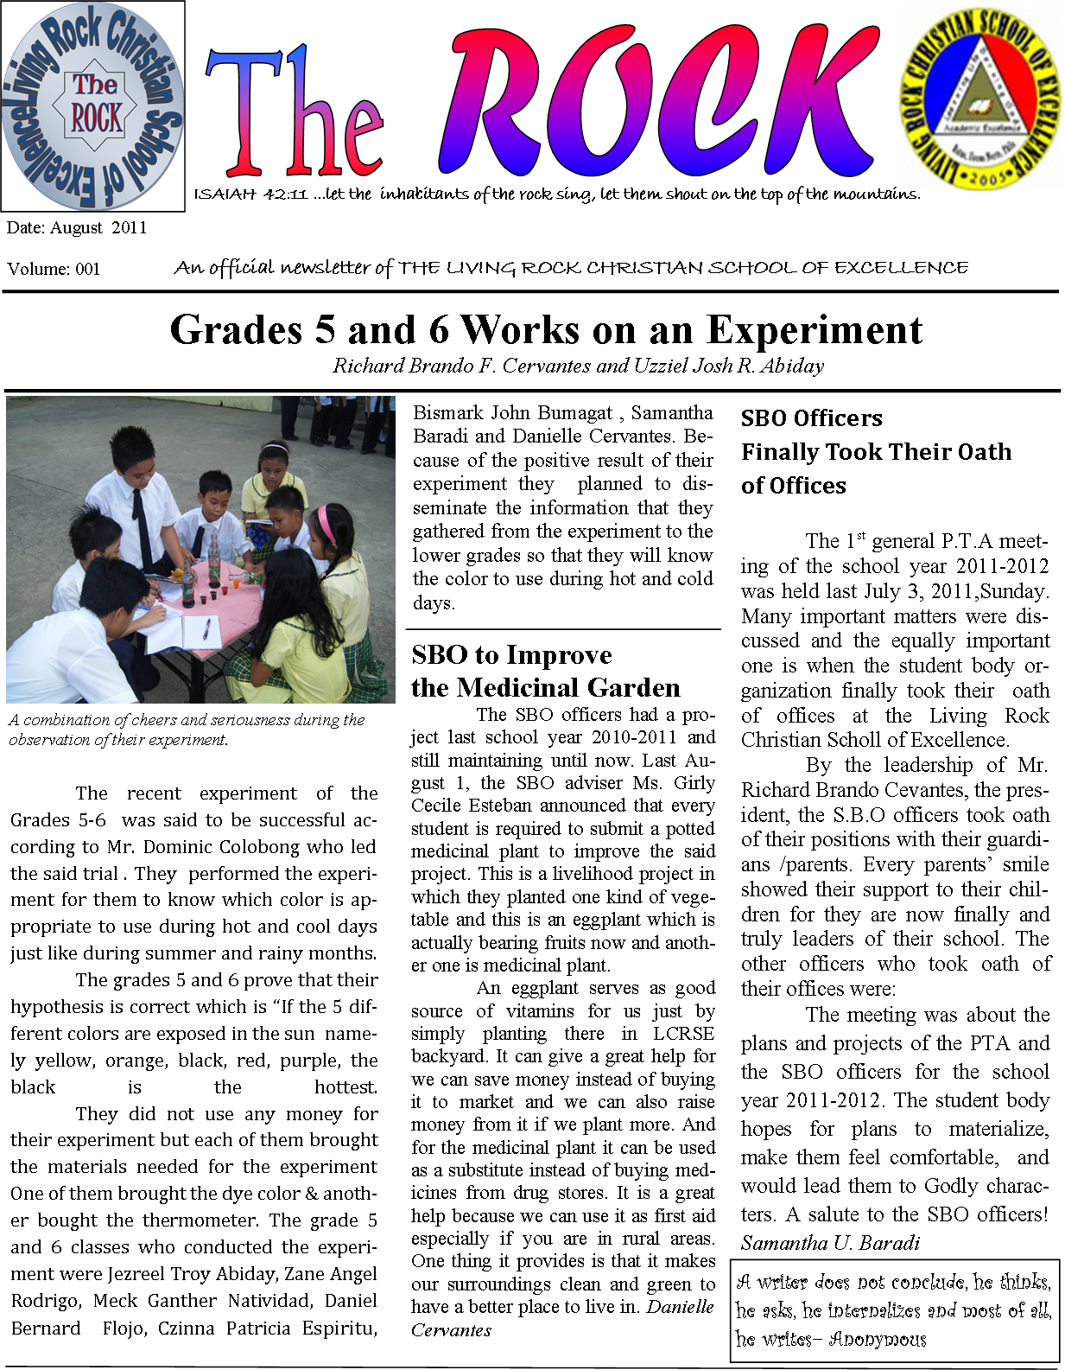

Some of Our Activities
School Paper
The school paper is handled by Ms. Clenntroy Guzman and Mrs. Alma Aguinaldo as the Editorial Adviser . Chosen writers are from Grades 3-6. This is our first attempt to come up with a school paper.

Slide 20
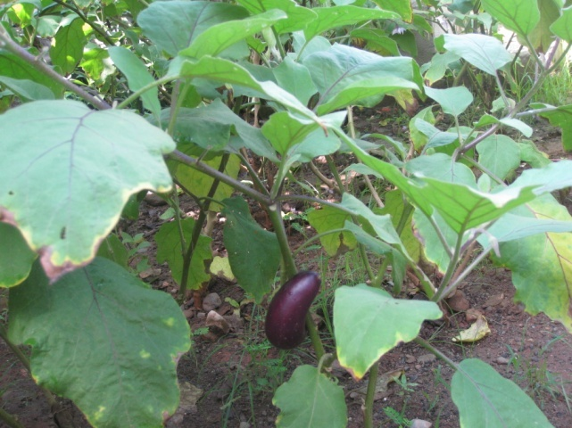
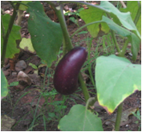
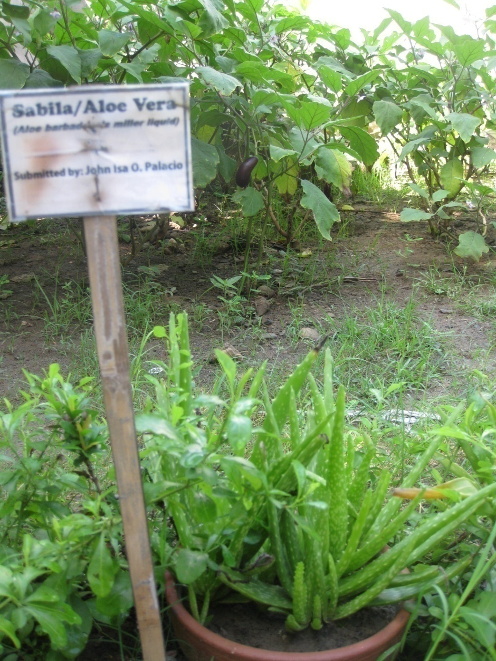
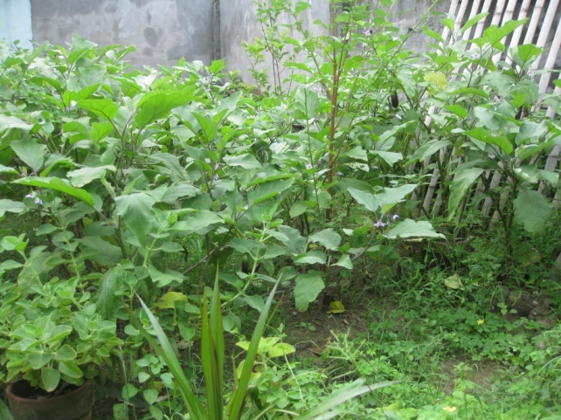


Some of Our Activities
We built vegetables and medicinal GARDENs.

Slide 21


Some of Our Activities
We enhance learning through group learning

Slide 22



Our Challenges
Department of Education wont give a recognition to the school because of the following :
We do not own our building and lot.

Slide 23



Our Challenges
2. Facilities are inadequate

Slide 24


Unfinished School canteen and Chapel ceilings
Canteen
Chapel

Slide 25


Unfinished parent’s nook

Slide 26
Our Challenges
3. The amount we receive from tuition fees are not
enough to sustain School operation.
4. 80% of the parents are Catholic... Academics is regarded first
Than spirituality of the children.
5. Rent of the building keeps on increasing and next year it will be
increased with 30% higher and 10% per year after, because we
already developed it and we had it at the lower rent before we
rent it.

Slide 27


Plans for the future
Looking forward to school year 2012-2013, the school administration envisions to open with God’s limitless grace, the high school in 2012-2013.
For now, the Living Rock Christian School of Excellence continues to reach one child one at a time, inculcating in their young minds Academic Excellence, Learning Life and Serving God.

Slide 28

Thank You and
MABUHAY FROM THE PHILIPPINES!

Slide 29
Thank You and Mabuhay!

