Slide 1
Evangelism “Conduct yourselves with wisdom toward outsiders, making the most of the opportunity. Let your speech always be with grace, seasoned as it were with salt, so that you may know how to respond to each person.” Colossians 4:5-6
Conviction, Contacts, Caring, Charisma

Slide 2
Conviction
Luke 6:39-40
Jesus makes us (His disciples) to be like Him
Who is more important than what
2 Corinthians 4:13
If we believe, we speak!
Why is more important than how
No silver bullet
Example of OFC seminar on evangelism
My dad – stick a knife in your heart

Slide 3
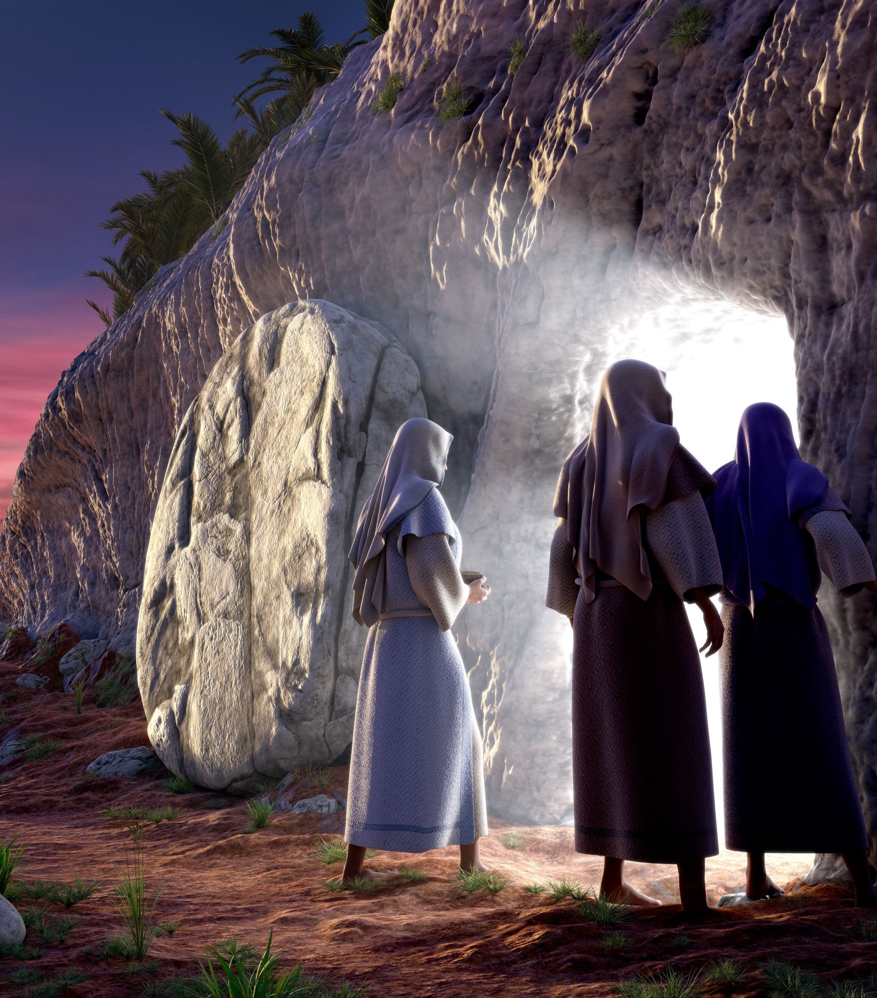
Conviction – about Christ
Challenge:
Rejection
1 Thessalonians 1:5
Full conviction
1 Corinthians 2:1-2
What do you want people to know you for?
John 1:41,45; 4:29
When we have conviction about who Jesus is, we have to tell others
Mark 5:19
Gratitude for what Jesus has done for us motivates us to share with others
Challenge:
Vulnerability
and shortcomings

Slide 4
Conviction –about the Church
John the Immerser preached the coming kingdom
Jesus preached the coming kingdom
Apostles preached the kingdom
Ephesians 4:4-6
People have a serious problem with one church
Do you have conviction about this?
You can’t like Christ, but despise His wife
You can’t be committed to Christ without commitment to His church

Slide 5
Conviction – about the condition of the lost
Revelation 20:15
Jude 1:22-23
James 5:19-20
Save the ones you can reach
Acceptance or lack of acceptance doesn’t change a person’s standing with the Lord
Challenge:
Loved ones that
didn’t make it
Challenge:
Family
And those who think they
Are already saved

Slide 6
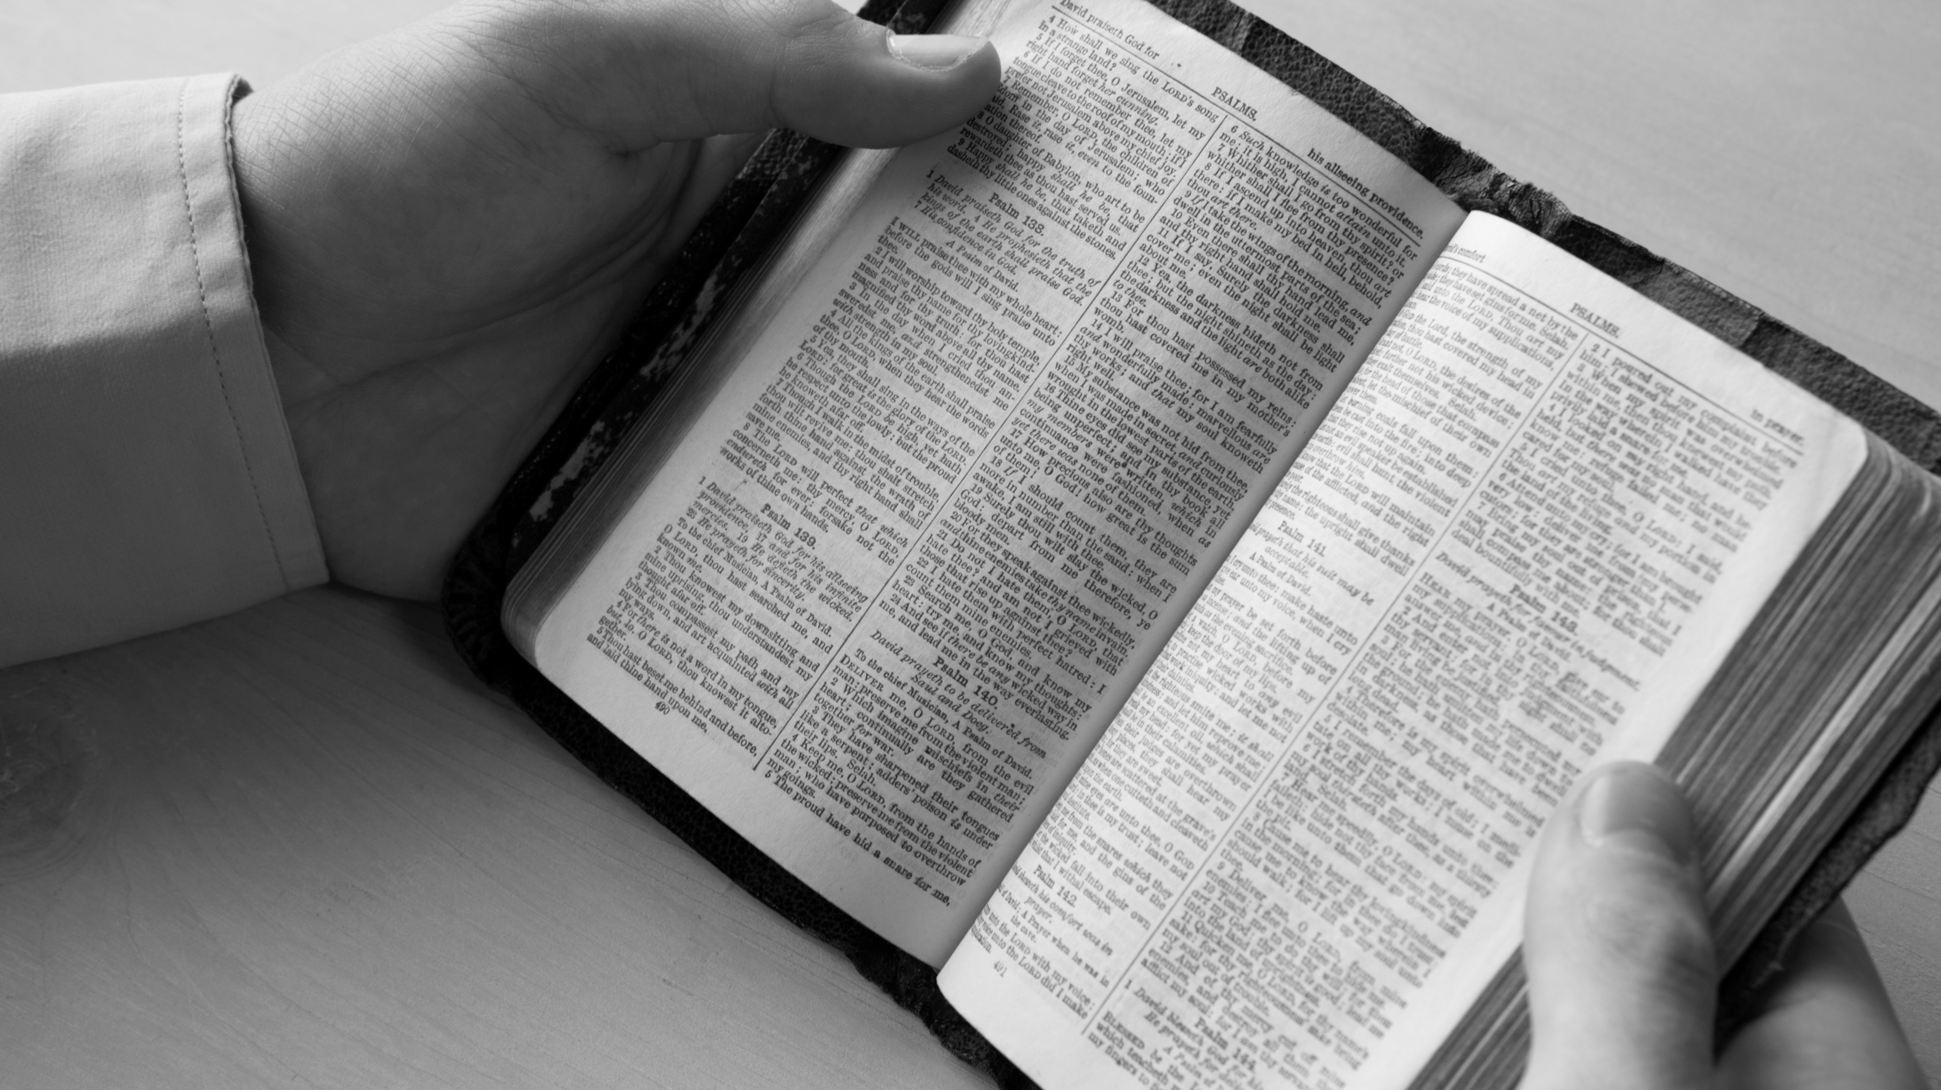
Conviction – about the Bible
John 12:48
Revelation 20:12
John 10:35

Slide 7
Contacts – sowing the seed!
Challenge:
Judging the soil /
Culture / apathy
Luke 8:11
The seed is the Word of God
1 Corinthians 3:7
We aren’t responsible for the type of soil
We just sow the seed
God causes the growth
John 18:37
No pressure – just tell the truth in love
Challenge:
Wasted investment
Challenge:
Fear of saying
The wrong thing
Challenge:
Getting people
To sit down and study
Notes:
“It’s harder to be friendly to those who don’t have their lives together, and to those who are struggling. But those are the ones who need it most and a lot of them are willing to listen to Jesus.” “Blessed are the poor in spirit.”

Slide 8
Contacts – making the most of the opportunity
Challenge:
Lack of KNowledge
Challenge:
Self doubt
Spiritual Preparation
Study
2 Timothy 2:15
Dig the wells deep
Preach from the overflow
Prayer
Acts 2:42, Acts 6:4, Matthew 17:19-21
Who does it really depend on?
Colossians 4:2-4, Matthew 10:16
Challenge:
Workplace rules
Speech control

Slide 9
Contacts – making the most of the opportunity
Challenge:
Initial interest /
approach
Ecclesiastes 3:11
Mental Preparation
Expect a positive response
Mentally practice opening lines
Run race 1000 times before stepping on the track
Sales calls
Courting
Set your mind to get a Bible study
Example of Amway guy – outside grocery story
Challenge:
When to ask for the study

Slide 10
Contacts – action
Challenge:
When to ask for the study
Matthew 7:7
Keep asking
Keep seeking
Keep knocking
Matthew 28:19-20
Go!
Jesus sets our priorities
Challenge:
Time management
Challenge:
Getting contacts

Slide 11
Caring – honest love as a foundation
Matthew 22:36-39
God will only bless our efforts if they are done in love
1 Corinthians 13:1
Nobody profits without love
People don’t care how much you know until they know how much you care
Challenge:
Heart break

Slide 12
Caring – Willingness to extend yourself
Matthew 5:41
Christianity has been called the religion of the second mile
Meet at their convenience
Coffee shop
Their home
Your home
Be consistent
If you cancel, it gives them an out
Before becoming Christians, people don’t always understand the urgency
We must emphasize the importance by our example

Slide 13
Caring – willingness to listen
James 1:19
Example of guy who thought he could establish that he was the teacher by dominating the conversation
Talking without listening communicates selfishness
All great teachers are good listeners
Challenge:
How to keep people interested

Slide 14
Caring – teaching to overcome objections
Challenge:
Misconceptions of
christianity
Isaiah 1:18
We are asking people to reason – to think things through
2 Timothy 2:24-26
Example of person arguing about immersion
Why don’t you agree?
Let’s look and see
Don Fletcher
Favorite houses as a salesman
“No solicitors” signs
Last time they really bought a lot
Objections are a good thing
I worry more about people with no objections

Slide 15
Caring – willingness to tell the truth under duress
Challenge:
Family or others getting mad
And causing friction
2 Timothy 4:2-3
Sometimes you need to have your axe and your two 38s
Example of Baptist deacon
Catholic fellow stormed out of my house
Homeless person kicked me out of his “pad”
Some people make it
Have to risk the relationship to save the soul

Slide 16
Caring – willingness to deal with all the issues
Acts 20:20
Sin
Finances
Addiction
Marriage problems
All Scriptural issues, including eternity
Acts 5:20
Public settings can be very difficult
You against the crowd
Challenge:
Public declaration

Slide 17
Caring – willingness to be persistent
Challenge:
persistence
1 Corinthians 13:7
People sometimes aren’t ready at first
Remember the rich young ruler
We don’t know if he ever came around
Jesus didn’t burn bridges
How about Nicodemus and Joseph of Arimathea?
How about many of us?
Someone stuck with us

Slide 18
Caring – willingness to “dust off your feet”
Acts 13:50-51
There is a time to move on
Ask for commitment
Conditions on discipleship
Next!!!!
Challenge:
Easier to go back to previous contacts
Challenge:
When to move on

Slide 19
Charisma – enjoy what you are doing
John 15:11
If you do this simply because you have to, you won’t be good at it
Learn to enjoy the fight
One of my greatest joys in life – good Bible studies with nonbelievers

Slide 20
Charisma – be interested in the material
Luke 10:38-42
How can you expect others to be interested in the material if you are bored just because you have seen it before?
Example of Amway guy – mortality rate of policeman
Whether you lead the study or are helping out with it, you should be interested!

Slide 21
Charisma – make the presentation your own
Paul often spoke of “my gospel”
Philippians 1:5
Participation in the gospel
Others develop tracks to run on
If you just plod through the material, you demonstrate lack of preparation and lack of interest
Personalize it
Use your own examples
Be yourself
My pre-proof study

Slide 22
Charisma – be interested in them as people
Jesus always cared about people
Matthew 15:32, Matthew 8:1-3, Matthew 19:25-26
People are very important; each one is an eternal soul
We are not in a high pressure sales presentation
We don’t want people to have buyer’s remorse
We aren’t just trying to get people dunked
We are trying to help them make it to heaven
We are interested in developing long-term relationships with them in Christ
Challenge:
Believe that they can make it

Slide 23
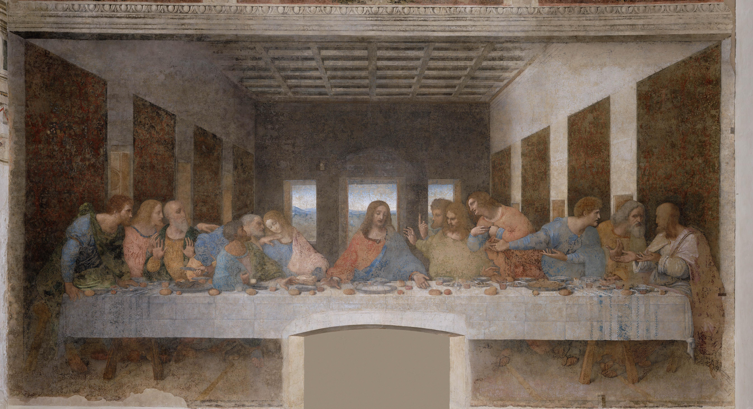
Charisma – developing fellowship with Christ
1 John 1:3
We through the word do what the apostles did
2 Peter 1:1
NKJV – “like precious faith”
Best fellowship – battle buddies
Fellowship with Christ and each other

Slide 24
Charisma – enthusiasm
Ephesians 5:18
Be filled with the Spirit
Enthusiasm comes from two Greek words, meaning “God within”
Christians can truly be enthusiastic
People should see Christ within us
We proclaim Him with our lips and with our lives
Challenge:
Having the right spirit

Slide 25
Conclusion
“Conduct yourselves with wisdom toward outsiders, making the most of the opportunity. Let your speech always be with grace, seasoned as it were, with salt, so that you may know how to respond to each person.”
(Colossians 4:5-6)

